Slide 1
Structured Text
One Shot
© 2022 John Sefcovic and Oakland Community College.

Slide 2
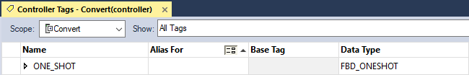
ONE SHOT RISING
Studio 5000
A One Shot use the Data Type FBD_ONESHOT.
Function Block Diagram programming was developed before Structured Text and rather than developing additional Data Types FBD data is used.

Slide 3

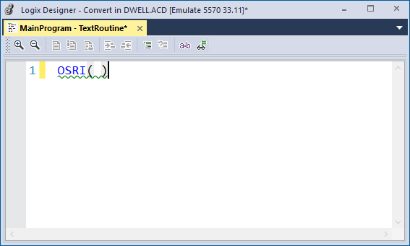
ONE SHOT RISING
Studio 5000
The One Shot Rising (OSRI) is in the Bit tab in the Instruction Palette and is dragged into the Editor.

Slide 4
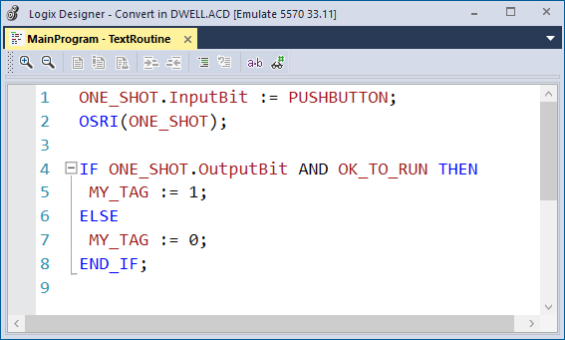
ONE SHOT RISING
Studio 5000
.
ONE_SHOT.InputBit - The condition to trigger the One Shot.
ONE_SHOT.OutputBit - The pulsed One Shot rising output.

Slide 5
ONE SHOT RISING
Studio 5000
The OSRI instructions Tag in this example is ONE_SHOT.

Slide 6
ONE SHOT RISING
Studio 5000
ONE_SHOT.InputBit is trigger by the Tag PUSHBUTTON.

Slide 7
ONE SHOT RISING
Studio 5000
ONE_SHOT.OutputBit is used as a condition to pulse a Tag for one scan.

Slide 8
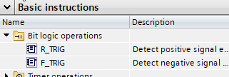
ONE SHOT RISING
Siemens
The Detect positive signal edge (R_TRIG) is a One Shot Rising in the Bit logic operations folder and is dragged into the Editor.

Slide 9
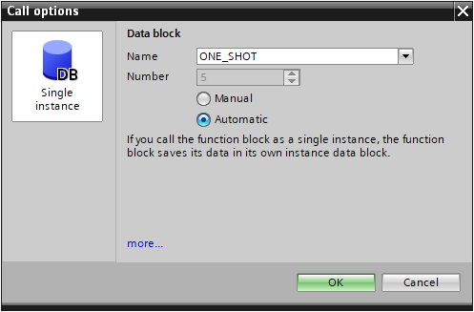
ONE SHOT RISING
Siemens
A dialog opens when the R_TRIG instruction is dragged into the program, the tag name in this example is ONE_SHOT. The One Shot is a System block and Program resource.

Slide 10
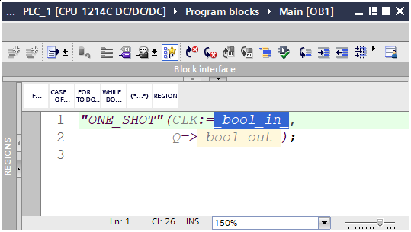
ONE SHOT RISING
Siemens
The One Shot instruction is added. Notice the R_TRIG is not shown.

Slide 11
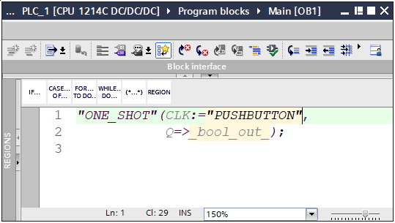
ONE SHOT RISING
Siemens
Double left click to select the CLK: Tag element.
Type in the quotation mark and select the Tag from the Tag Listing.

Slide 12
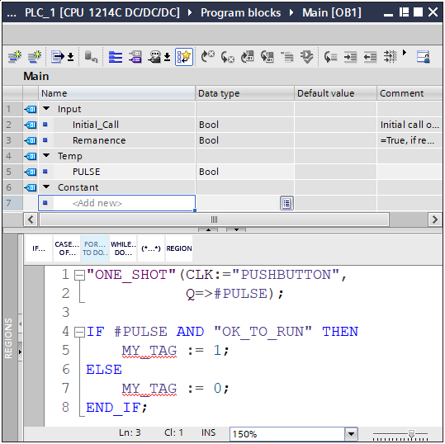
ONE SHOT RISING
Siemens
In this example the Output is assigned a “local” Instance named PULSE.

Slide 13
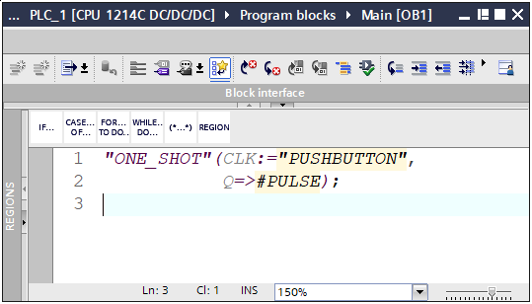
ONE SHOT RISING
Siemens
Double left click to select the Q: Tag element.
Type in # hash mark and select the Tag from the Tag Listing.
If a PLC Tag or Data Block Tag is used type the quotation mark.

Slide 14
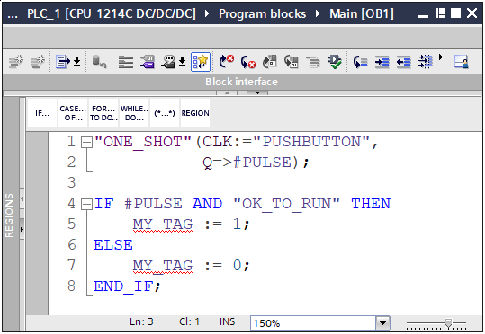
ONE SHOT RISING
Siemens
The CLK: is trigger by the Tag “PUSHBUTTON”.

Slide 15
ONE SHOT RISING
Siemens
The Q=> will cause leading edge output signal to the Tag #PULSE.

Slide 16
ONE SHOT RISING
Siemens
#PULSE is used as a condition to pulse a Tag for one scan.
The

